Slide 1
Process Mining in the Wild
12 July 2019
Zsolt VARGA, ECALab
zsolt.varga@eca.europa.eu

Slide 2
Process Mining Safari
Case study 1: process mining as a new form of data representation
EU public consultations, a relatively simple case
Case study 2: process mining for conformance checking
Audit of EU agencies, a bit more complicated
Getting the data, extracting from pdf files, data protection
Adding calculated fields in the event log
Fluxicon disco vs. Prom6
Case study 3: exploratory process mining in „big data”
CA Service Desk manager database tables
Text mining methods for making sense of process data

Slide 3
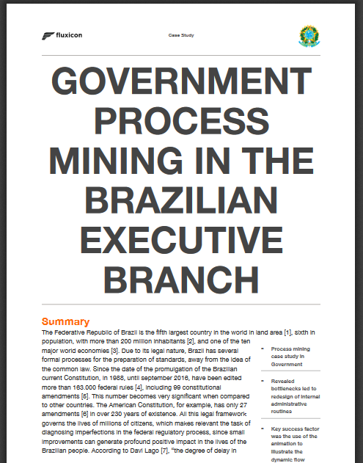
Process mining in the government sector
https://fluxicon.com/blog/2018/12/case-study-government-process-mining-in-the-brazilian-executive-branch/
Inspiration for using process mining in performance audit. It made me try PM on the audit on public consultations.
Process data is everywhere!
http://romualdoalves.com/decretos-2015-a-2018-poc-text-mining/

Slide 4
Process Mining for performance audit Case study 1: European Public Consultations
Page 4

Slide 5
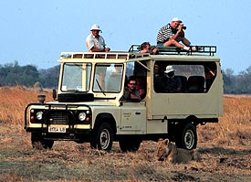
Process Mining Safari Part 1: playing it safe

Slide 6
Audit case
Audit question: How are public consultations implemented by the Commission?
Dataset: Excel file about the various steps of public consultations and their start dates
Business need: visualise the relative durations of PCs compared to each other and show deviations from the „ideal” process path

Slide 7
Input data for process mining
Cons_ID | Event | Start | End_theoretical
PC-10 | Survey (National Authorities) | 2014-09-01 | 2015-02-01
PC-10 | Conferences | 2014-11-01 | 2016-03-01
PC-10 | Expert/focus groups | 2015-03-01 | 2016-02-01
PC-1 | Roadmap | 2015-05-07 | 2015-06-04
PC-18 | Survey (other) | 2015-06-26 | 2015-09-01
PC-11 | Roadmap | 2015-07-23 | 2015-08-20
PC-20 | Roadmap | 2015-09-28 | 2015-10-26
PC-11 | Expert/focus groups | 2015-10-01 | 2016-05-01
PC-10 | Workshops | 2015-10-01 | 2015-10-31
PC-5 | Roadmap | 2015-11-30 | 2015-12-28
PC-12 | Roadmap | 2015-12-08 | 2016-01-05
PC-19 | Roadmap | 2015-12-08 | 2016-01-05
PC-10 | OPC | 2016-01-12 | 2016-04-06
PC-8 | Roadmap | 2016-01-18 | 2016-02-15
PC-9 | Conferences | 2016-02-01 | 2017-10-01
PC-11 | OPC | 2016-02-15 | 2016-05-31
PC-11 | Survey (other) | 2016-02-15 | 2016-05-31
PC-1 | OPC | 2016-03-01 | 2016-06-01
PC-20 | Interviews | 2016-03-15 | 2016-08-24
PC-14 | Expert/focus groups | 2016-04-01 | 2017-04-01
Open public consultations: events and start/completion dates for each event within an OPC.
Process data is everywhere!

Slide 8
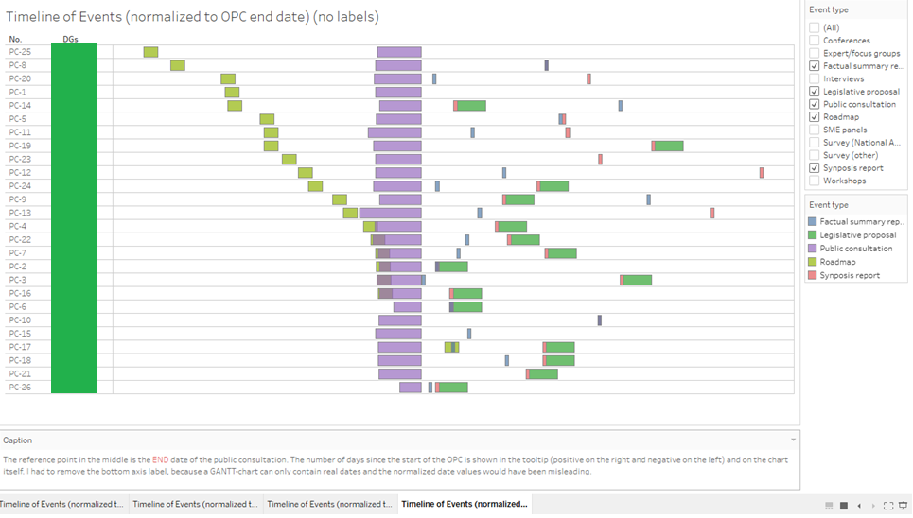
Tableau viz, pretty close, but static, concurrencies shown as overlaps
Data protection lesson 1: DO NOT show anything that is considered to be non-public or proprietary information

Slide 9
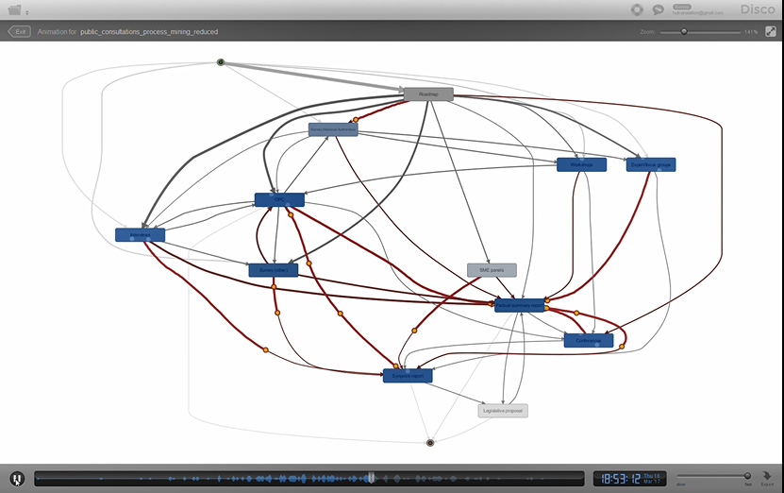
Full OPC process (spaghetti)

Slide 10
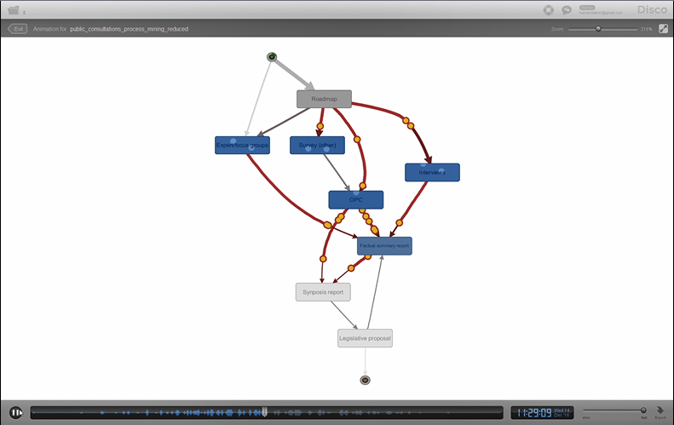
Simplified OPC process (layered, „lasagne” process)

Slide 11
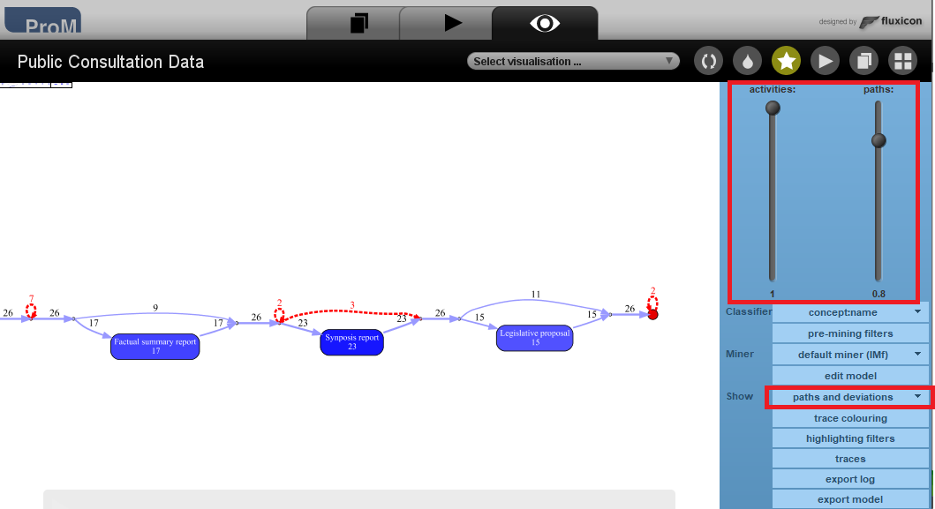
Process conformance checking on automatically inferred model
Inductive Visual Miner plugin in ProM

Slide 12
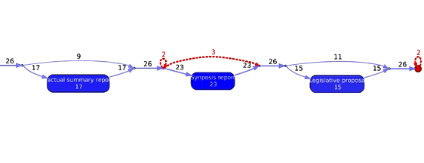
Process conformance checking on automatically inferred model
3 OPCs didn’t have a synopsis report
2 OPCs had additional steps after the legislative proposal

Slide 13
Lessons learned
There’s process data everywhere
ProM/Disco is suitable for visualising performance audit results
Replaying the log on the process model adds the time dimension by animating the path of the traces in the model
A great way to communicate complex ideas quickly. When I demonstrated it to a visiting delegation, they immediately spotted the fact that two consultations didn’t finish at the legal proposal (no need for prior briefing).

Slide 14
Audit of EU agencies Visualising and conformance checking of agency payments
Page 14

Slide 15

Process Mining Safari Part 2: a closer look at the beast

Slide 16
Audit case
Audit question: How can we automate the audit of EU agencies’ payment processes?
Dataset: the EC’s accounting system has all the required data for certain types of agencies, but there are obstacles to directly getting the data from the database tables
Business need: visual representation of the process workflow highlighting process deviation and non-compliance with duty segregation and deadlines

Slide 17
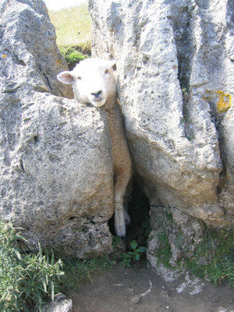
Small detour (between rock and a hard place)
IT people and database experts
Business area / audit chambers
ECALab / data scientist

Slide 18
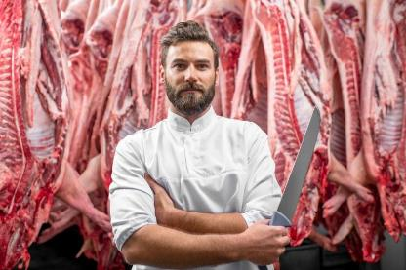
Small detour (between rock and a hard place)
Data protection officer
Business area / audit chambers
IT staff and database experts
ECALab / data scientist

Slide 19
Access to data + data protection concerns
Read-only access to the raw database of the Commission
Not much use without a data dictionary

Slide 20
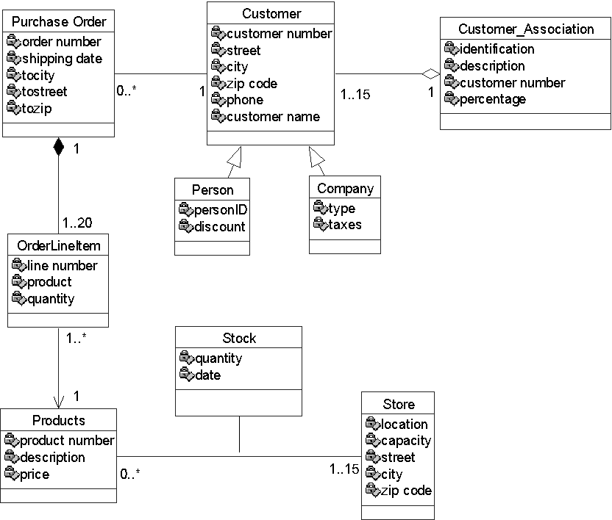
Relational database model

Slide 21
What you are likely to get for process mining

Slide 22
What you are likely to get for process mining
Data protection lesson 2: Stay away from personal data as much as possible!!

Slide 23
What you are likely to get for process mining

Slide 24
What you are likely to get for process mining

Slide 25
Access to data + data protection concerns
Read-only access to the raw database of the Commission
Not much use without a data dictionary
Access to data warehouse
DW reports (that I’ve seen) do not contain workflow information

Slide 26
Access to data + data protection concerns
Read-only access to the raw database of the Commission
Not much use without a data dictionary
Access to data warehouse
DW reports (that I’ve seen) do not contain workflow information
Data may only be accessible through pdf exports
No meaningful database connection or custom legacy systems

Slide 27
Access to data + data protection concerns
Read-only access to the raw database of the Commission
Not much use without a data dictionary
Access to data warehouse
DW reports (that I’ve seen) do not contain workflow information
Data may only be accessible through pdf exports
No meaningful database connection or custom legacy systems
Dataset contains user IDs and agency names
We are allowed to process such information for audit purposes, but I cannot show you real data in my presentation
I created a synthetic dataset based on the original, fully anonymised, with fictional agency names, and added some fictional anomalies

Slide 28
Audit of EU agencies Information extraction from pdfs
Page 28

Slide 29
Why?
PDF is evil. Although it is called a PDF “document”, it’s nothing like Word or HTML document.
PDF is more like a graphic representation. PDF contents are just a bunch of instructions that tell how to place the stuff at each exact position on a display or paper.
In most cases, it has no logical structure such as sentences or paragraphs and it cannot even identify a text box properly.
PDFs require a disproportionate amount of resources to extract data in a structured format.
PDFs are not meant for electronic processing. They are meant for printing!

Slide 30
Information extraction pipeline
Pre-process documents
Perform pattern matching
Extract info from matches
Consolidate in a machine readable format
Regular expressions
Linguistic features
Always corpus specific
Page 30

Slide 31
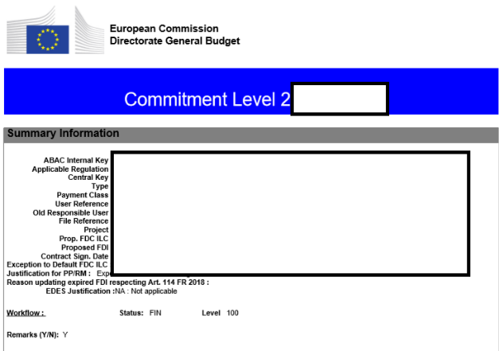
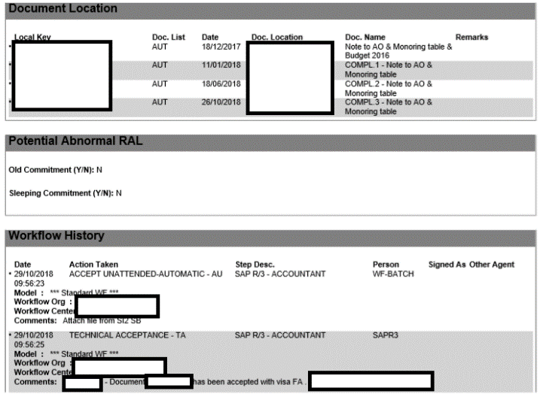
Agency payment transactions
Question 1:
What are the amounts falling under non-statistical sampling?
200 folders, each with several pdf files
Question 2:
What are the amounts paid into financial instruments?
Auditors would have to read almost a thousand pdfs, then find and copy-paste the relevant amounts!!!

Slide 32
A possible pdf data extraction workflow
Camelot + pdfMiner libraries for Python
only works with text-based PDFs and not scanned documents
each table is a pandas DataFrame, which seamlessly integrates into ETL and data analysis workflows.
My recommendation after much sweat and blood:
use pdfMiner to find and identify the part of the document containing the table you need
Use Camelot-py with the parameters you got from pdfMiner to extract the table
each dataset requires fine-tuning, exception handling and post-processing

Slide 33
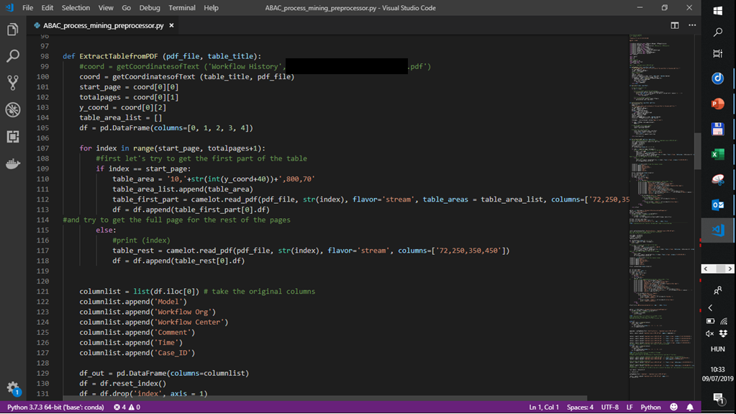
Python code for data extraction
A bit of hacking is needed to customise the extraction to the specificities of the dataset

Slide 34
DISCLAIMER:
The data, all agency names, anomalies and incidents portrayed in this dataset and process mining experiment are fictitious. No identification with actual persons (living or deceased), positions, organisations and events is intended or should be inferred.
Even though the structure of the data closely follows that of the European Commission’s accounting system, this presentation does not imply that the EC’s control systems allow for any of the shown anomalies to occur.

Slide 35
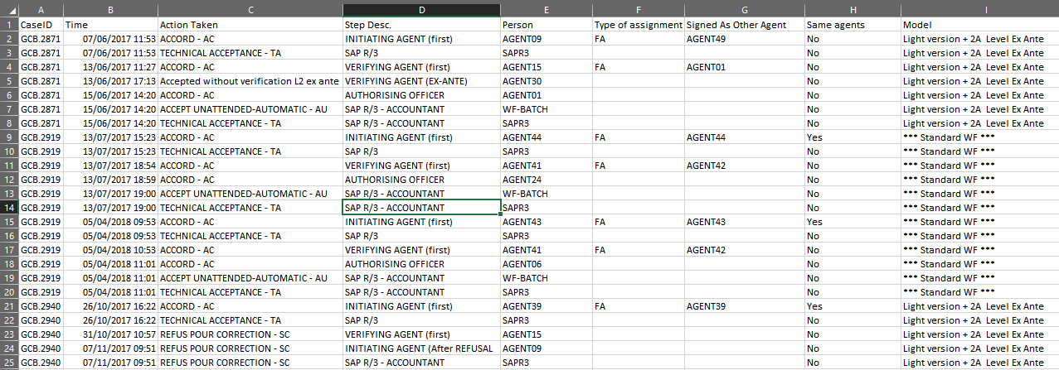
ABAC workflow data
Calculated field, shows if the same agent used another function
Process log created on the basis of data extracted from 20 pdf files, semi-randomly chosen by auditors among various agencies

Slide 36
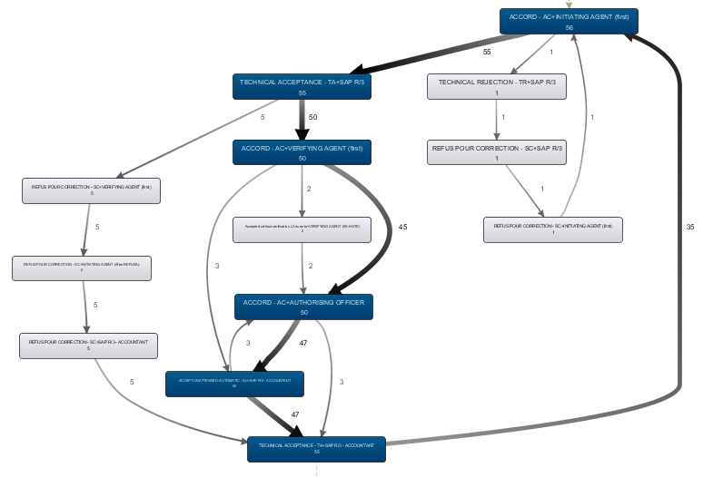
ABAC workflow data
Frequency based display, the darker the more frequent
Full process model based on 20 transactions. Looks good!

Slide 37
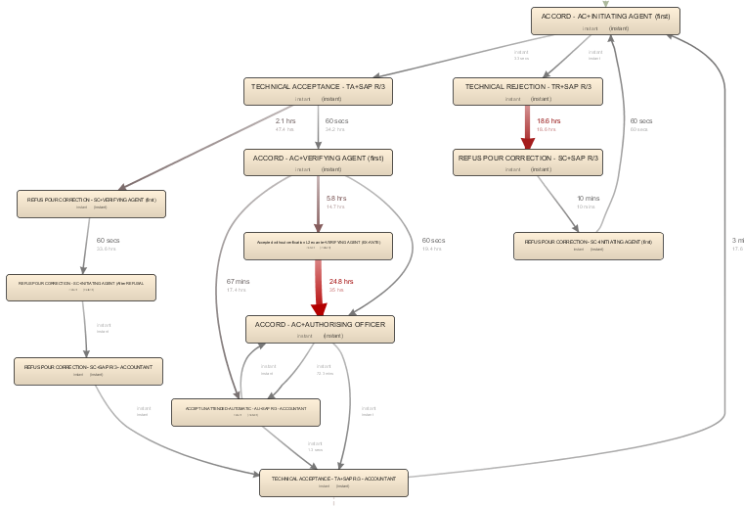
ABAC workflow data
ABAC workflow data
Displaying mean duration, with minimum duration as a secondary metric. Outliers are interesting!
Durations: first step of performance checking

Slide 38
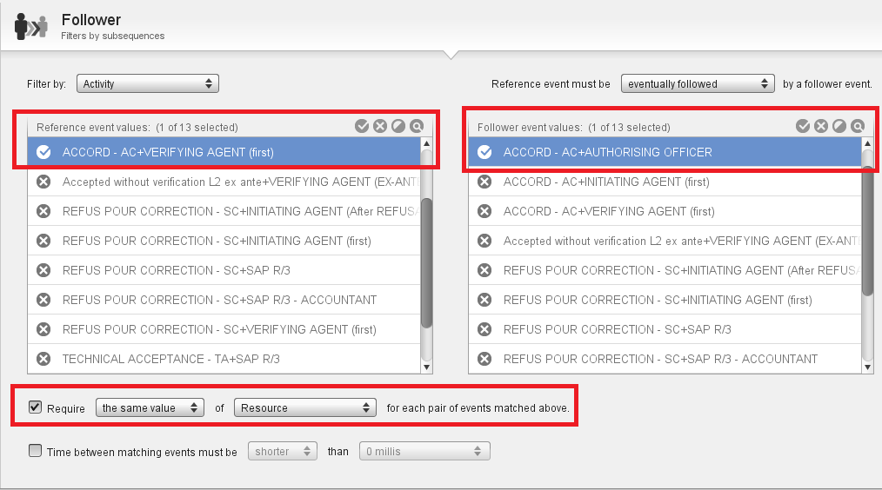
ABAC workflow data
Compliance check: segregation of duties
Follower filter in Disco. As an auditor, you are looking for non-compliance, so you filter for the occurrence of the anomaly (you want to see the risky population)

Slide 39
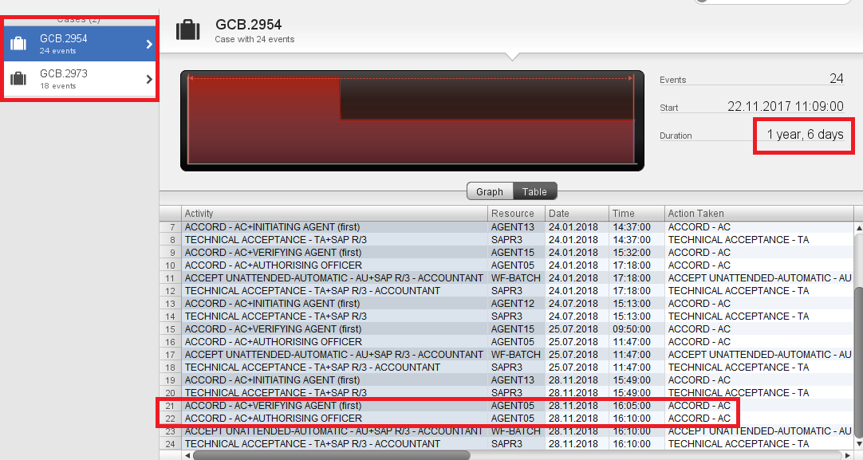
ABAC workflow data
Compliance check: segregation of duties
Violation of segregations of duties occurs twice in the population, and at the same agency, and for cases having a total duration over a year
Agent 5 acted as verifying AND authorising officer. Maybe he just wanted to speed up the closure of long cases?

Slide 40
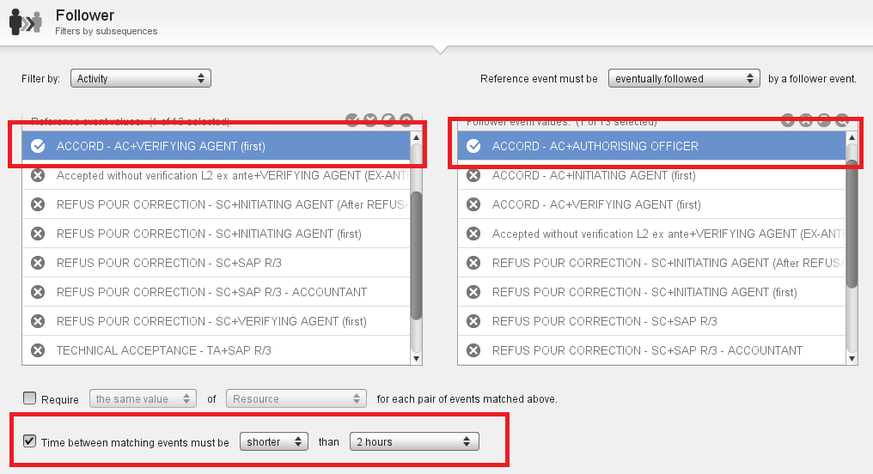
ABAC workflow data
Compliance check: suspiciously short approval times
Use the Follower filter and set a time limit. You can stack filters on top of each others (filter by variant, attributes, duration, you name it) to drill into the population by criteria

Slide 41
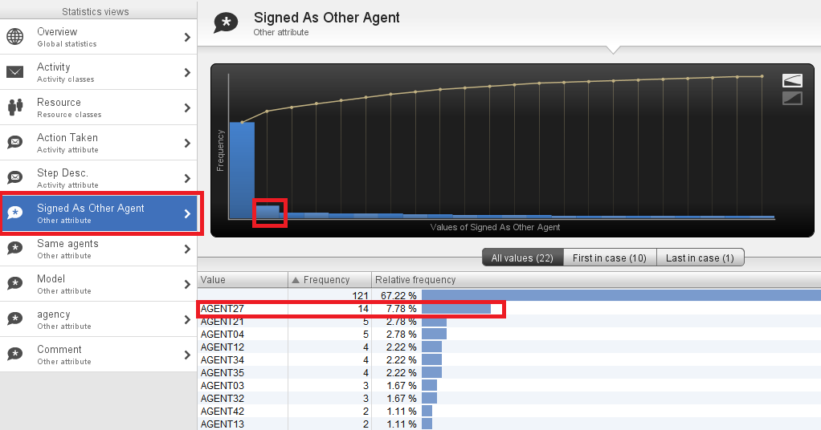
ABAC workflow data
Compliance check: suspiciously short approval times
Out of all cases with suspiciously short aproval times, Agent27 uses delegated access the most
Let’s see if suspiciously short times correlate with a user signed in as an other user (delegation letter?)

Slide 42
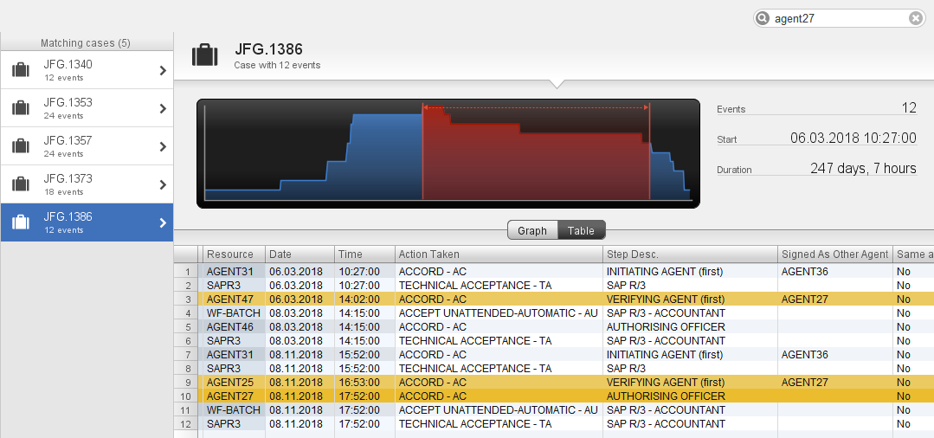
ABAC workflow data
Compliance check: suspiciously short approval times
Now, this is interesting: VA signed in as the AO followed by AO approval within an hour?
Agent27 works for the imaginary agency JFG.

Slide 43
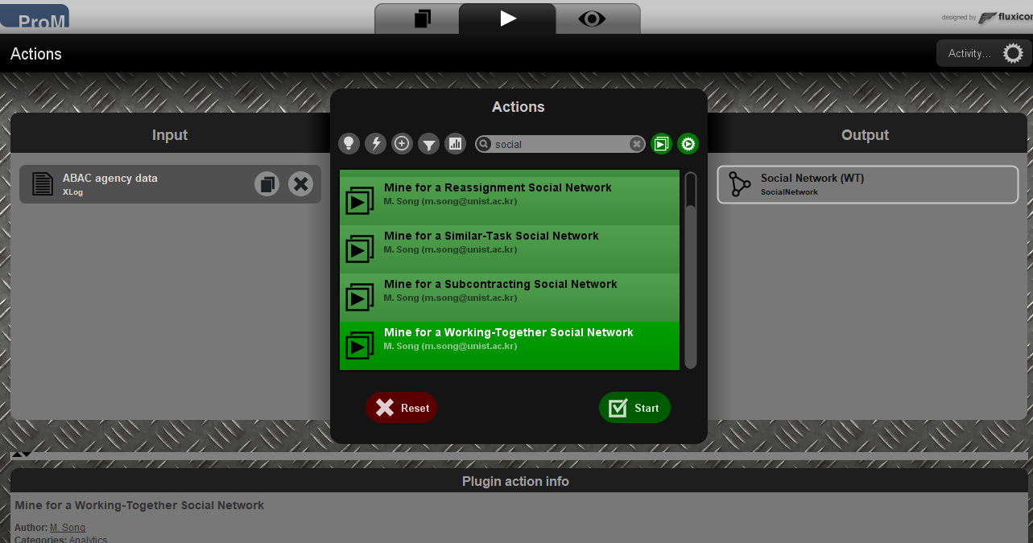
Creating a social network based on the event log
ProM is a framework with a large number of plugins. A social network graph is just another representation of the same data. In a conformance checking context, it is very useful to examine links within „populations of interest” that you isolate from the full population

Slide 44
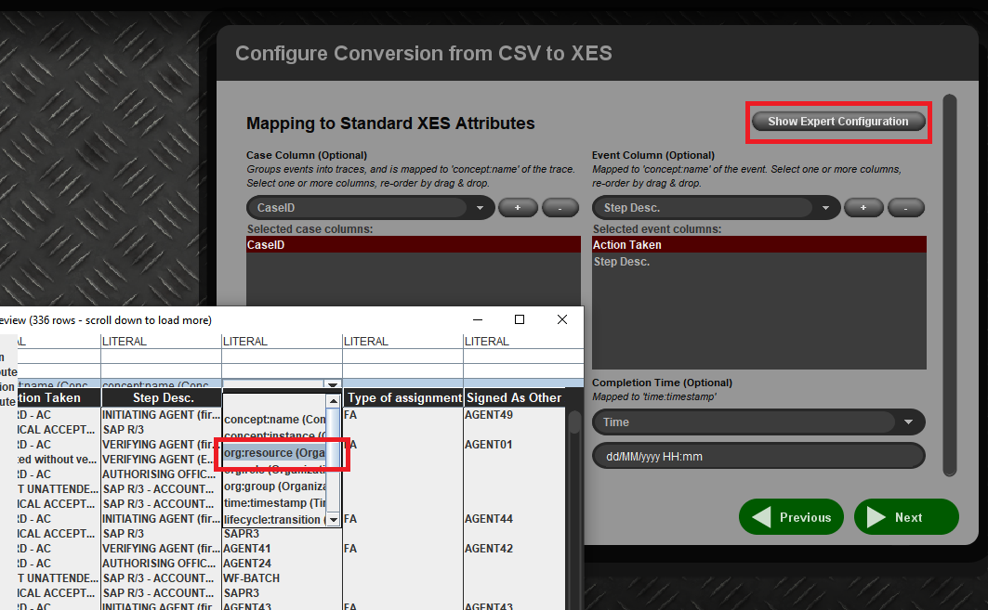
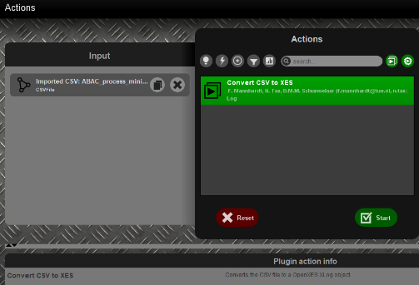
Import/conversion settings are important!!!
You need to specify the column containing person names or users at conversion time by cicking on Show Expert Configuration and choose „org:resource”
In ProM you have to import the .csv file first, and then convert it into an event log file!

Slide 45
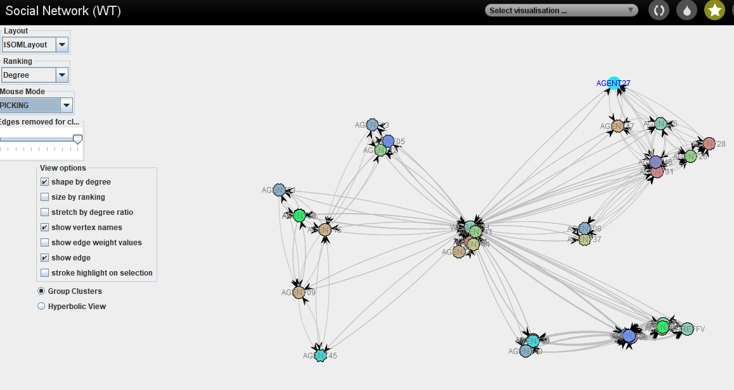
Creating a social network based on the event log
Our friend, Agent27 from the previous exercise
Working together social network in ProM, using the same agency dataset
These might be authorising officers, who act as gateways between normal employees and the accounting system (the transactions go through them for processing, but they don’t otherwise interact with other agents)

Slide 46
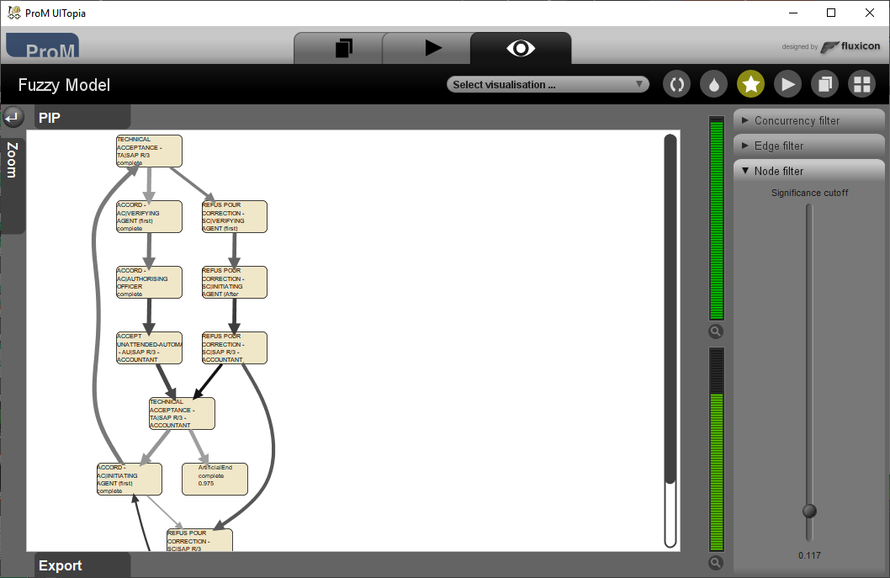
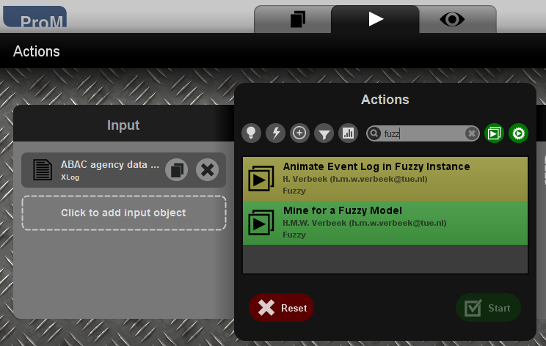
Replaying full event log on simplified process model
First create a fuzzy model based on the log and export it in ProM (and maybe add artificial start and end points)

Slide 47
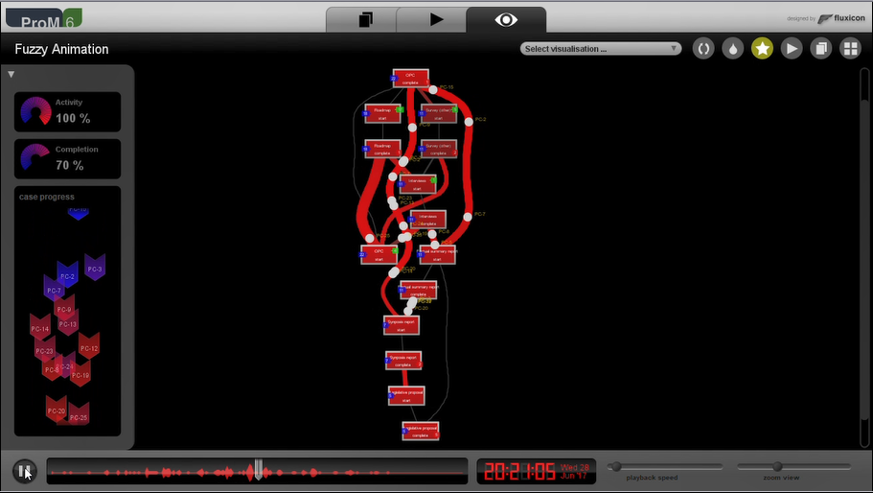
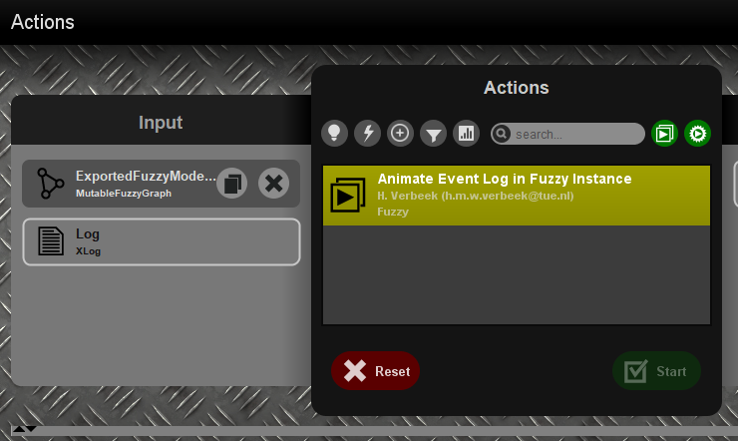
Replaying full event log on simplified process model
Replaying the full event log on a previously agreed model provides useful conformance and performance information (red, green, blue counters)

Slide 48
Conformance checking in ProM
There is a separate conformance checking plug-in in ProM that I have not covered in this presentation due to lack of time
It works a bit differently than what I’ve shown in the previous slides
Once a process model is agreed between auditor and auditee, the conformance checking results could be considered as audit evidence
The ProM framework also allows you to write your own plugin in Java, so if you need checks that the system cannot currently do for you, you can implement them yourself in a plugin

Slide 49
Lessons learned
In the worst case scenario, we can still extract useful process data from pdf files for prototyping (still needs manual touch-up, not suitable for production)
We don’t need much data to build the process model if the process is well-structured, 20 transactions gave us a useable model
ProM/Disco is suitable for conformance checking, with certain limitations
Some pre-processing is required to add event features (e.g. same agent with different logins/functions)
No interactive display of non-conformances in Disco, need to use filters, Celonis might be a better option for this purpose (under investigation)

Slide 50
Mining Service Desk log files for process improvement
Page 50

Slide 51
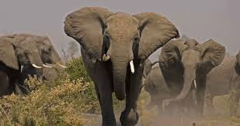
Process Mining Safari Part 3: being run over by an elephant

Slide 52
Business case
Audit question: Explorative analysis of business processes with a view to potential process improvements
Dataset: MS SQL server export from CA Service Desk Manager, containing only the keys, not the resolution for persons names, requestors etc.
Business need: to gain experience with data extraction and process mining software, determine what can be done within PM software, what pre-processing steps may be required for client systems, etc.

Slide 53
My expectations
Easy win, we just retired the system, accessing historical data on a non-live system should not be complicated
It’s a service desk management system, processes should be well-defined
I could present something useful relatively quickly to convince people about the advantages of process mining

Slide 54

Reality
Data protection officer
Zsolt
IT department / database managers

Slide 55
The reality
According to the DPO everything had to be anonymised, I did not extract ANY personal data so that we wouldn’t have to do extra administration
Even the case IDs had to be encrypted, so they could not be traced back to actual persons
Almost as many variants in the original as many cases
French AND English event descriptions which had to be merged
Emails had to be deleted using regexp, proper names had to be removed using Spacy EN/FR language models (NER)
Explorative analysis had to determine the best splits of the data

Slide 56
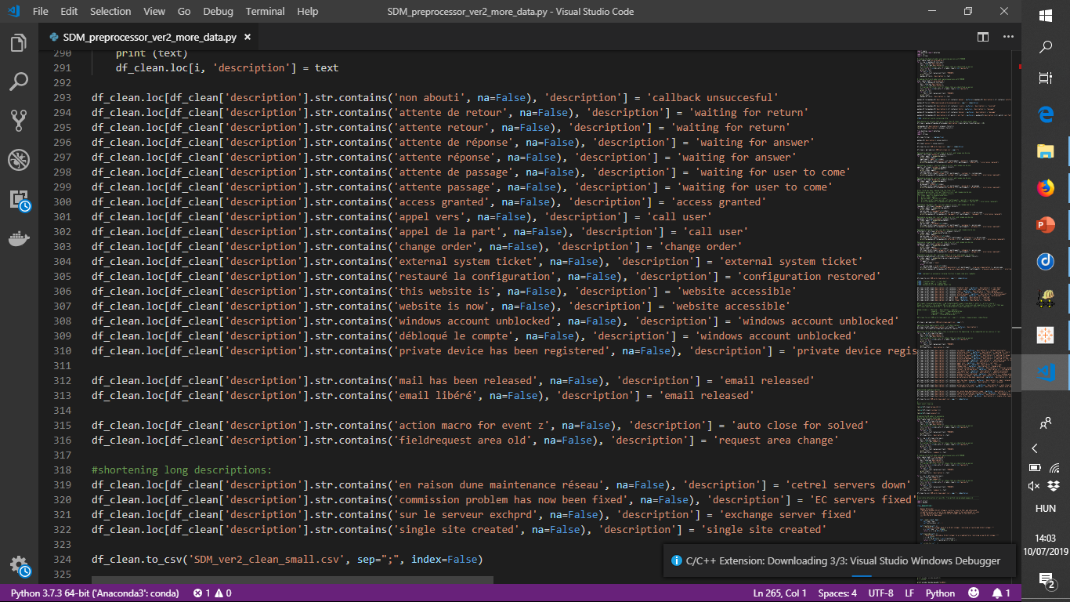
Pre-processing in Python, merging similar events

Slide 57

My face when I first saw the resulting process graph
#màzlithecat

Slide 58

My face when I first saw the resulting process graph

Slide 59

My face when I first saw the resulting process graph

Slide 60

My face when I first saw the resulting process graph

Slide 61

My face when I first saw the resulting process graph

Slide 62

My face when I first saw the resulting process graph

Slide 63
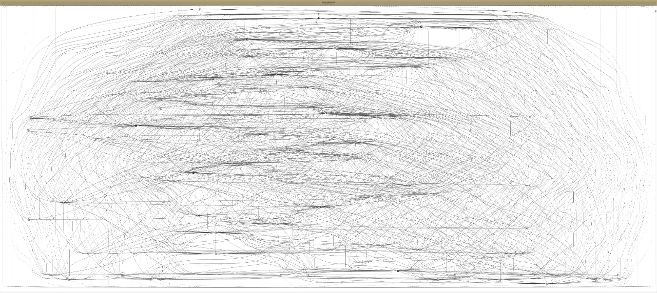
The process graph derived from the pre-processed „simplified” log
Still a real spaghetti monster, but if you look closer, there is structure and some layers + focal points are already visible. There might be hope!

Slide 64
How to make lasagne out of spaghetti
It might as well be as difficult as turning water into wine
Slice and dice! Explore the dotted chart, correlations, histograms, patterns.
It might be the case that the log contains not one, but several processes, so you need to separate them!
Talk to the business area and develop an intuition for recognising recurring patterns.

Slide 65
Good old Pareto principle
80/20 rule
20% of the cases/events cause 80% of the variance

Slide 66
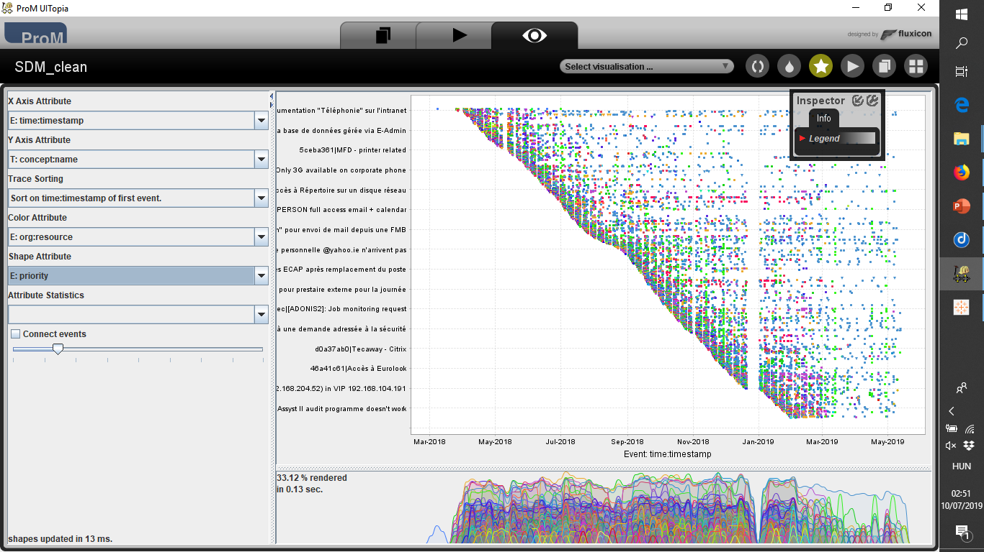
First look with ProM and the dotted chart view

Slide 67
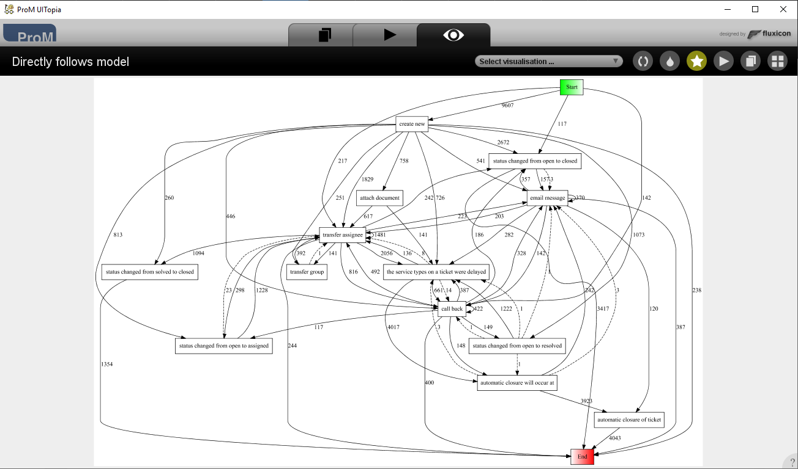
Directly follows graph

Slide 68
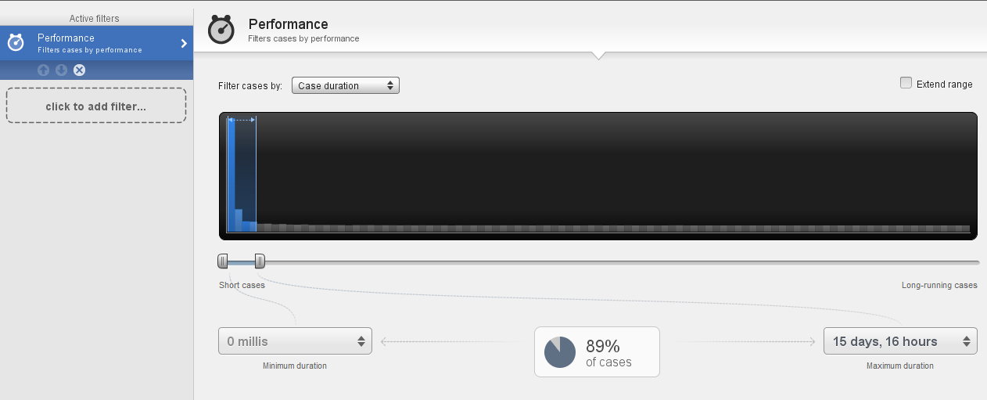
ABAC workflow data
Disco has easy to use, histogram based filters
89% of the cases are shorter than 15 days. Let’s try splitting up the log to cases solved within a day and to cases solved between 2 and 15 days

Slide 69
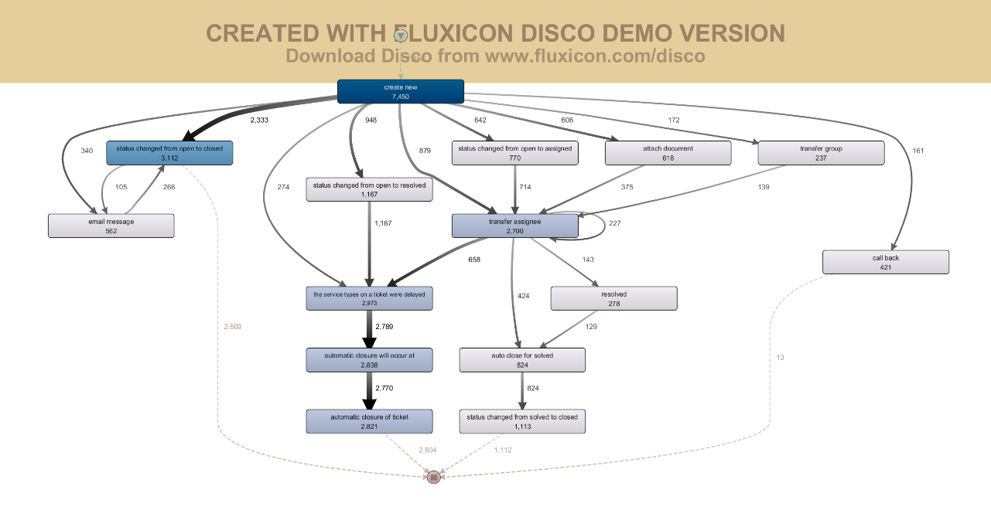
Split by duration (within a day)

Slide 70
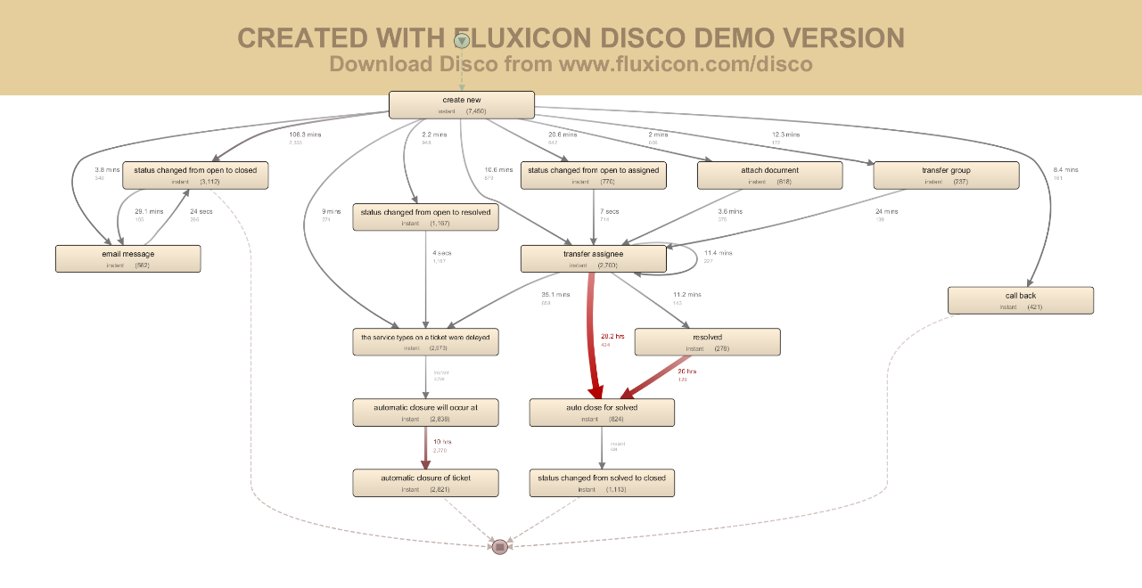
Split by duration (within a day)

Slide 71
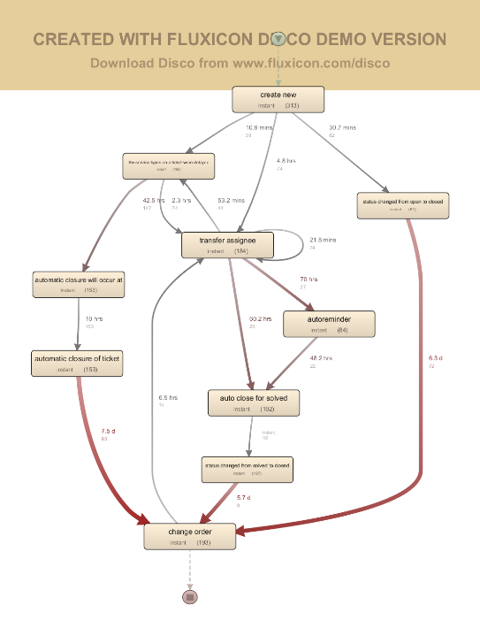
Split by duration (2-15 days)

Slide 72
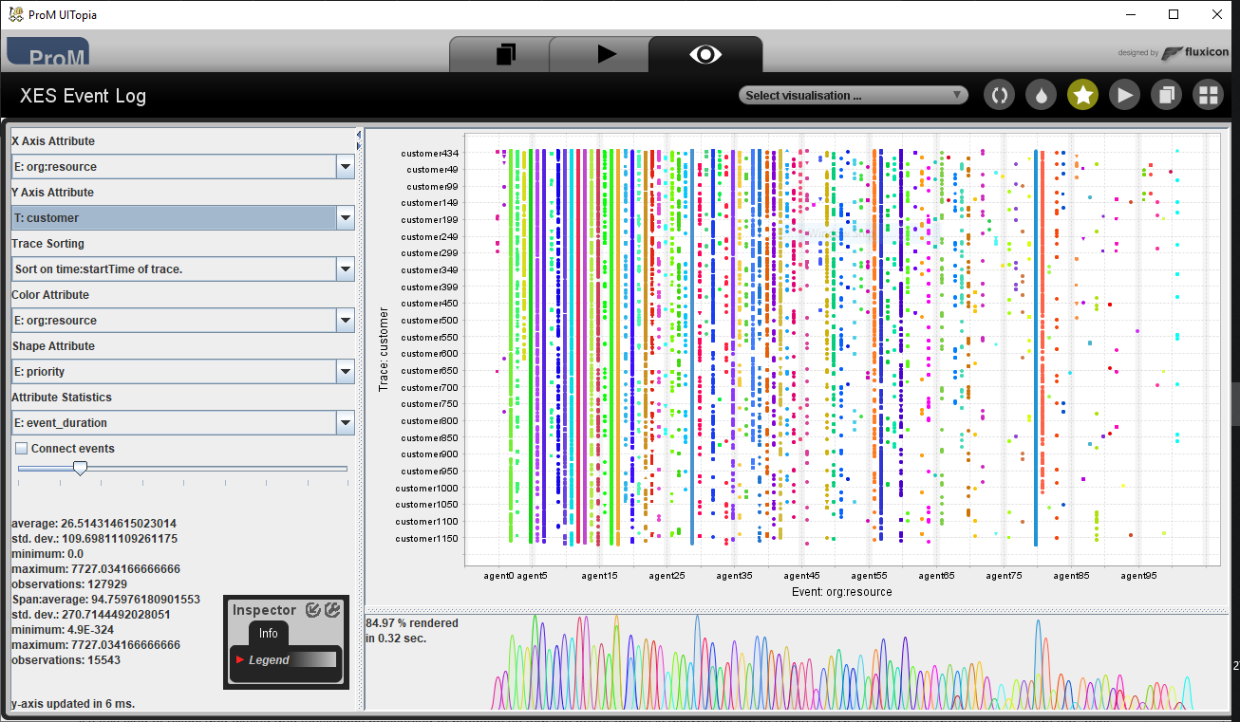
Agents vs Customers

Slide 73
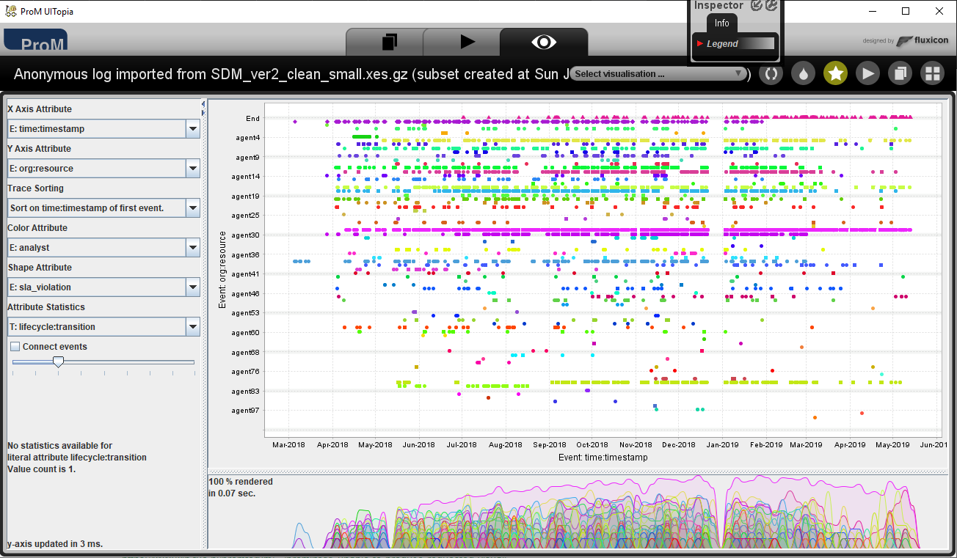
Agents vs time of activity

Slide 74
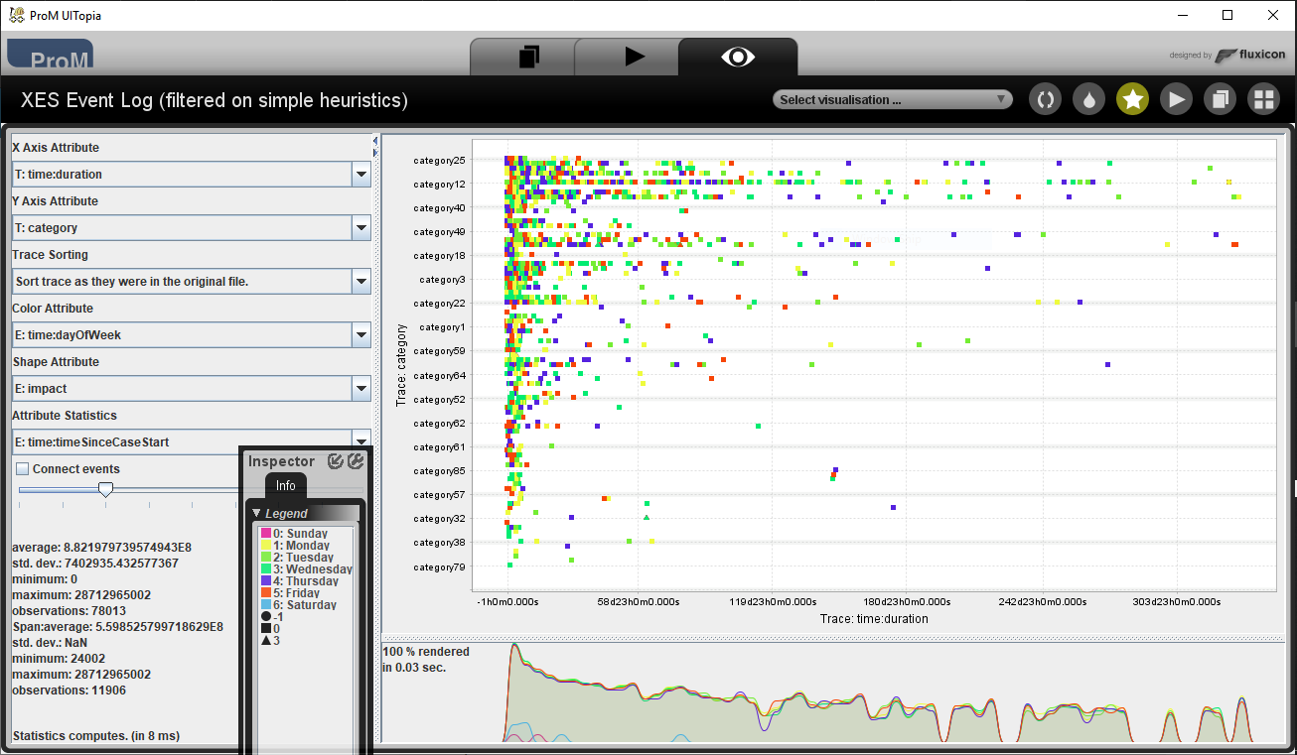
Duration, category vs time of the week

Slide 75
Lessons learned
DO NOT assume that an event log will be easy to understand
Use text mining tools to anonymise data, merge duplicate event names and quantify some of the unstructured textual data contained in description fields
Be careful! Log content may contain personal data in fields where you are not expecting it! (e.g.: email text copied into description fields)
Use your intuition and explore correlations and histograms
The dotted chart view of ProM is very useful to get a „feel” for the data, and Disco has very nice histograms to help you slicing up the log data

Slide 76
Recommendations
Start small: download a copy of ProM or Fluxicon Disco (demo) or register for Celonis cloud or contact Minit
Start small: find an existing dataset that may be a good fit for process mining explorations
Watch the Process Mining course on Coursera (https://www.coursera.org/learn/process-mining) and the ProM course on FutureLearn (https://www.futurelearn.com/courses/process-mining).
Read Wil’s book (https://www.springer.com/gp/book/9783662498507) and website (https://processmining.org)
Read Fluxicon’s online book (http://processminingbook.com/index.html)
Secret tip: The Flux Capacitor blog (https://fluxicon.com/blog) especially the older entries between 2011-2014 contain a lot of tips and tricks

Slide 77
Recommendations
Think big: if you are passionate you CAN make a difference
Think big: this is a unique opportunity where public sector audit can be ahead of the private sector
Act local: find out how automation/process mining can help your colleagues
Act local: find out how your organisation may benefit from this
Be realistic: it may or may not work out for you
Be realistic: the technology might not be mature enough for your use case, but it might be overnight. Anticipate the change!

Slide 78
QUESTIONS?
Email: zsolt.varga@eca.europa.eu
LinkedIn: www.linkedin.com/in/zsvarga/
GitHub: github.com/zseebrz
Tableau Public: public.tableau.com/profile/zsolt.varga#!/

